Slide 1
Mathematics Behind Deep Learning
Abdullah Ahmed

Slide 2
Overview
Deep learning is a method of machine learning where computers learn patterns by passing data through layers of mathematical functions.
It can be used for image recognition, speech recognition, and natural language processing to targeted advertising and drug discovery.
We use artificial neural networks to learn complex relationships from data, and these networks are built from layers of simple mathematical functions.

Slide 3

What is an Artificial Neural Network?
A neural network can learn a mathematical function that matches the data that we give it. This means we can treat neural networks as tools for fitting data the same way you would fit a line or curve to points.
It is built from layers of simple mathematical units called neurons.
Each neuron takes a weighted combination of inputs, adds a bias, and passes the result through a nonlinear function.
Adding layers allows the network to learn complex patterns that a single equation can’t.
Neuron: w = weights, b = bias,
Sigmoid= nonlinear function, a= inputs from previous layer

Slide 4

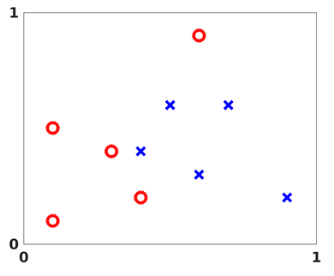
Example: Classifying Points in
The document gives an example dataset of points. Each point belongs to either category A or B (circles or crosses).
The goal is to build a neural network that takes a point and predict which category it would be in what is called a classification problem.
The network will learn a function that separates the two groups by adjusting its weights and biases.

Slide 5

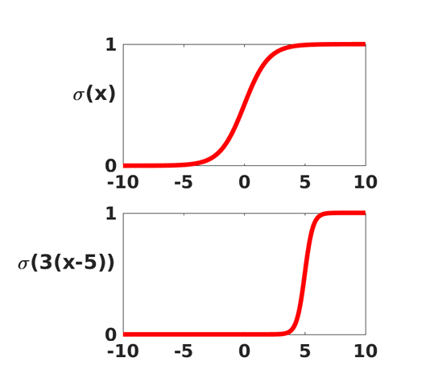
The Sigmoid Function
The article builds the network by using a simple, nonlinear function called the sigmoid function which is defined as
It is viewed as a smoothed version of a step function, which mimics the behavior of a neuron. So it outputs a value near 1 if the input is large and near 0 if the input is small.
The steepness and location can also be changed by shifting or scaling the input.

Slide 6

How a layer works
In each layer, every neuron forms its own weighted combination of the values coming from the previous layer, adds a bias, and then applies the sigmoid function.
If outputs from one layer are collected into a vector a, then the outputs from the next layer have the form
Where W is a matrix containing the weights, and b is a vector containing the biases.
The number of columns of W equals the number of neurons in the previous layer, and the number of rows equals the number of neurons in the current layer.
Basically each matrix W is shaped so that each neuron in the current layer receives one weight for every output from the previous layer.

Slide 7

The Four-Layer Network
The article uses an artificial neural network with four layers.
Layer 1 is the input layer that has two components since
The second layer has two neurons.
The third layer has 3 neurons.
And Layer 4 is the output layer with 2 neurons.
Each layer applies the operation from the previous slide and by composing these layers, the overall network defines the function:
The function depends on 23 parameters (weight matrices and bias vectors) and the goal is to choose these parameters so that the network correctly classifies the points from the figure

Slide 8
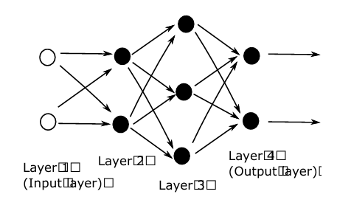
Four-Layer Network Imagery

Slide 9
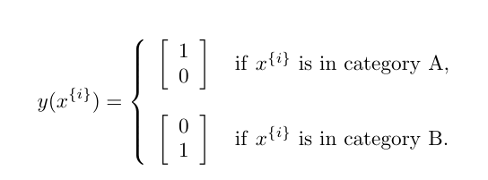
The Cost Function
Cost is a function of the weights and biases, and it is used to measure how well the network fits the data.
This function compares the network output F(xi) with the desired output y1 for each data point.
The article specifies a target output for each data point based on it’s category.
The cost is then used to measure how well the network fits the data.

Slide 10


The Cost Function Formula
Using the target outputs from the previous equation, the cost for this example is defined as:
This formula measures how close the network output is to the desired output for each of the ten training points.
The goal is to choose the 23 parameters so that the cost is as small as possible.
The factor ½ and averaging 1/10 are used to simplify later calculations and to compute mean error.

Slide 11
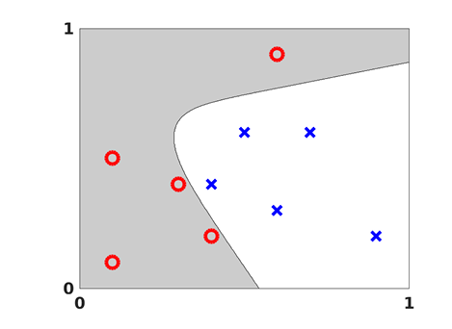
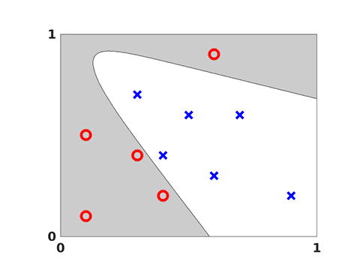
Visualization of output

Slide 12
The General Setup
We now move on to the general mathematical framework for artificial neural networks.
A neural network is viewed as a function that maps an input vector to an output vector through a sequence of layers.
Each layer has its own weight matrix, bias vector, and applies a nonlinear function like the sigmoid to the result of its weighted combination.
The goal is to choose all weights and biases so that the network approximates a desired mapping based on training data.

Slide 13

General form of a Neural Network Layer
In a general setup, a neural network has L layers with sizes n0, n1,,,,,nL. Where n0 is the dimension of the input and nL is the dimension of the output.
For each layer l= 1,….,L, the formula is:
Where W is the weight matrix, b is the bias vector, and sigmoid is the same nonlinear function.

Slide 14

General Cost and Training Objective
The cost function measures how well the network fits all N training examples. The general form is written as:
The training problem is to choose all weight matrices and bias vectors so that the cost is minimized.

Slide 15


Gradient Descent
Training a neural network means choosing the parameters that minimize the cost function. It is convenient to collect all parameters into a single vector p.
A common optimization method for minimizing cost is gradient descent.
Using a Taylor expansion, a small change Δp gives:
To reduce the cost we choose Δp in the direction of negative gradient which gives
Where the n is a small step size called the learning rate

Slide 16


Stochastic Gradient
Computing the full gradient can be tedious when the number of training points N is large.
So a better alternative is to replace the full gradient by the gradient from a single randomly chosen training point.
For a randomly chosen index i∈{1,2,…,N} , the update becomes
This method is called the stochastic gradient method and over many steps, it approximates the behavior of full gradient descent while reducing the computation per step.

Slide 17
Back Propagation
To train a neural network, we have to compute the gradient of the cost with respect to every weight and bias.
Computing these derivatives directly is extremely tedious because each weight affects the output through many layers.
Back Propagation provides an efficient way to compute all these gradients by applying the chain rule layer by layer moving backward through the network.
The idea is to define an error signal at each layer that measures how small of a change in that layer’s activation affects the cost.
Once they are known, the gradients of the cost with respect to the weights and biases can be computed fairly simply.

Slide 18


Back Propagation Formulas: Recall
To derive the expressions for the derivatives, we introduce two sets of variables. First we let:
Which is referred as the weighted input for a neuron j at layer l. Then the relation that activates the information through the network is writing as:

Slide 19




Back Propagation Formulas
Error at output layer:
Measures how sensitive the cost is to each neuron in the final layer
Error propagation for hidden layers:
Moves the error backward through the network layer by layer.
Gradient with respect to biases:
The error at each neuron is the gradient of the bias at that neuron.
Gradient with respect to weights:
Each gradient is the product of the error at the current neuron and activation from the previous layer.

Slide 20
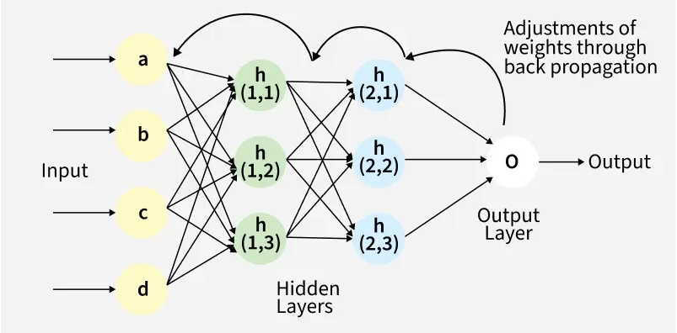
Back Propagation Visual

Slide 21
Image Classification and CNNS
We can use artificial neural networks and deep learning for more realistic tasks as well such as image classification.
Convolutional neural networks are a standard tool in computer vision applications.
Images contain thousands of pixels in 2-D grids.
CNNs use local filters that detect features like edges, corners, textures, and shapes.
These learned features combine across layers to enable the network to recognize, objects, faces, numbers, animals, and more.

Slide 22
Key Concepts in Image Classification
Overfitting happens when a trained network performs very accurately on the given data, but can’t generalize well to new data. This means it doesn’t learn general patterns well and leads to poor performance on new images.
Examples of ways to stop it include the dropout method, splitting the data into two distinct groups, and early stopping.
Dropout method randomly takes out some neurons during training so the network doesn’t rely on specific connections.
Splitting the data into two distinct groups, training data and validation data. This penalizes large weights.
Early stopping is when you stop the training as soon as the validation error begins to rise.

Slide 23
Why Use Neural Networks?
Neural networks learn patterns from complex formulas and can discover patterns as well from data.
They are used in computer vision, speech and audio recognition, game-playing (like chess), face recognition, and a lot more.
It is also easy to keep on improving these networks with training and layers as well.

